Slide 1
Pet Adoption & Homeless Animal Report Application
Yunan Shao

Slide 2
Problem Statement
More Families have kept pets or plan to have pets but not all of them have paid enough attention to their pets’ health.
Adoption is always a better option than buying a pet and can be done in a more convenient way.
Homeless animals can cause potential transmitted diseases and need to be rescued in time.

Slide 3
Solution
Adoption
Roles
Homeless Animal Report
Rescued homeless animals listed by animal healthcare organization.
Pets listed by other users.
Users:
Have both roles as Adopter and Owner
Homeless animal Reporter
Animal Shelter (Employee):
View homeless reports
Manage rescued animals
Users send report to animal healthcare organization
Reports are rearranged by priority on rescue team side.

Slide 4
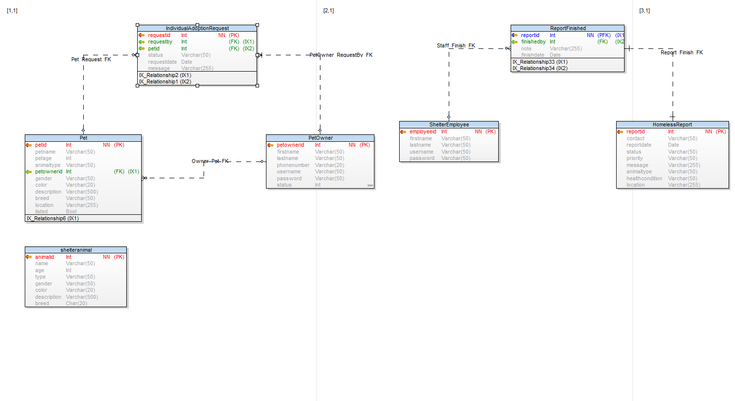
ER-Diagram

Slide 5
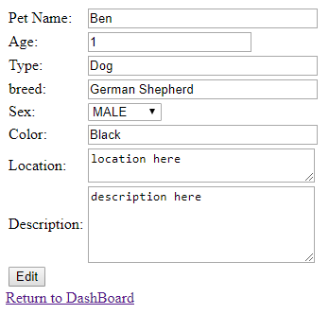
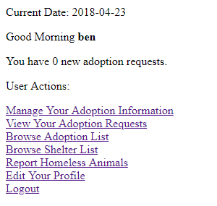
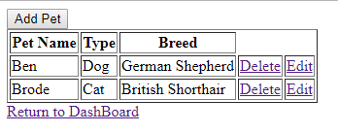
Use Case
Pet Adoption Information Management

Slide 6
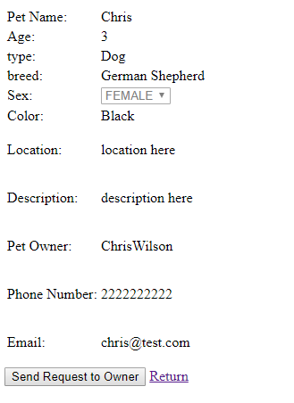
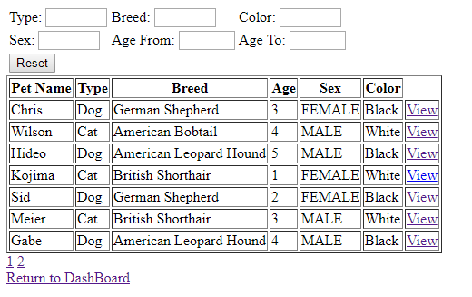
Use Case
Send & Receive Requests
Uses Ajax call & criteria query to query result and repopulate the table
Adoption Information
Individual/Shelter

Slide 7
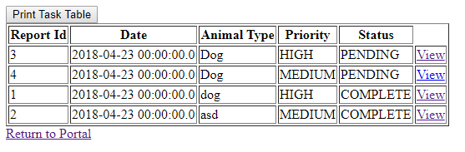
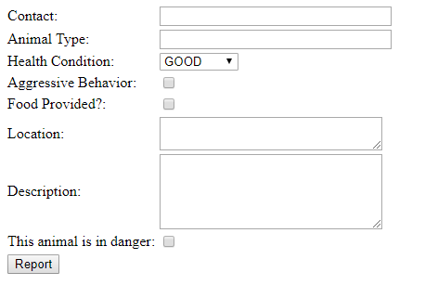
Use Case
Homeless Animal Report
Shelter side
User Side
Report priority is set automatically depending on report attributes
Rescue team can export all incomplete reports for printing

Slide 8
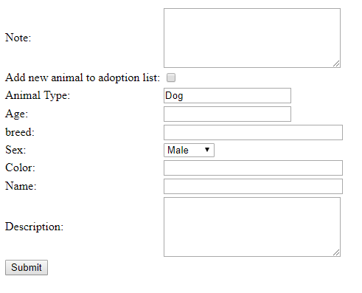
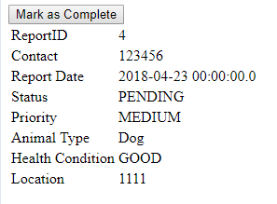
Use Case
Process Reports
Option for employee to add a new animal to the list for adoption

Slide 9
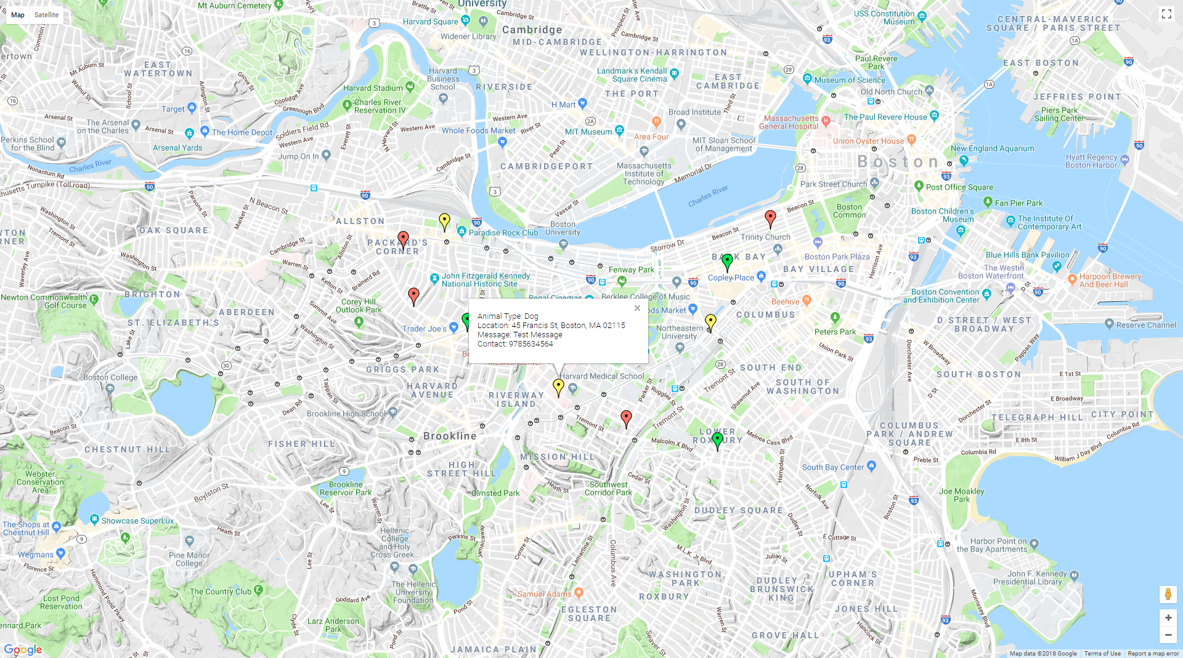
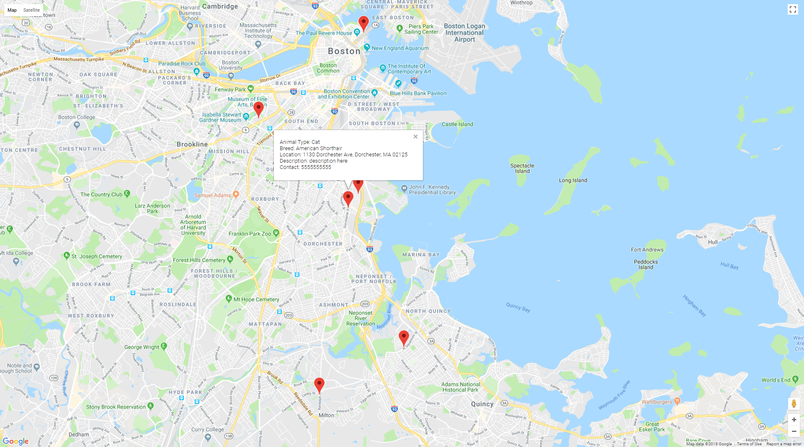
Use Case
Google Map Implementation
List<Report/Adoption Info> JSON
GeoCode
Lat/Lng
Address/Location
Markers on Map with JSON Attributes inside InfoWindow

Slide 10
Thank you

